Slide 1

OLIST DATASET ANALYSIS: OVERVIEW AND INSIGHTS
PRESENTED BY AMAL FAROUK

Slide 2

OLIST DATASET OVERVIEW
THE OLIST DATASET IS A PUBLIC DATASET FROM A LARGE BRAZILIAN E-COMMERCE PLATFORM.
It contains detailed data on orders, customers, products, sellers, and customer reviews.
The dataset is used for analyzing sales performance, delivery performance, customer satisfaction, and more.

Slide 3
KEY PERFORMANCE INDICATORS (KPIS)
TOTAL REVENUE: THE TOTAL VALUE OF SALES TRANSACTIONS.
Total Profit: Revenue minus costs (freight and product costs).
Profit Margin Ratio: Percentage of profit earned per sale.
Order Count: The number of orders made on the platform.
Average Delivery Time: The average time between order placement and delivery.
WEEKDAY VS WEEKEND REVENUE

Slide 4
DATA PREPARATION
IMPORTED AND EXPLORED THE OLIST DATASET, ENSURING DATA INTEGRITY.
Created relationships between key tables (e.g., orders, products, payments, location) using primary keys like order_id.
Extracted date fields (year, month, day) from the order_purchase_timestamp to analyze trends over time.
Cleaned the data by handling missing values and correcting any data inconsistencies.

Slide 5
MAJOR WINS
Total Revenue
Total Profit
$16M
$165K
Average Delivery Days
Total Orders
12 Days
135K

Slide 6

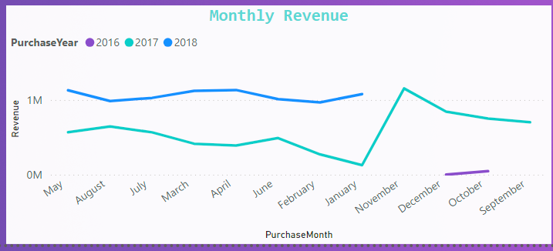
REVENUE MONTHLY REPORT
Highest Revenue was in November 2017 with Revenue $1.1M
Lowest Revenue was in January 2017 with Revenue $128K
Need more data for the year 2016

Slide 7

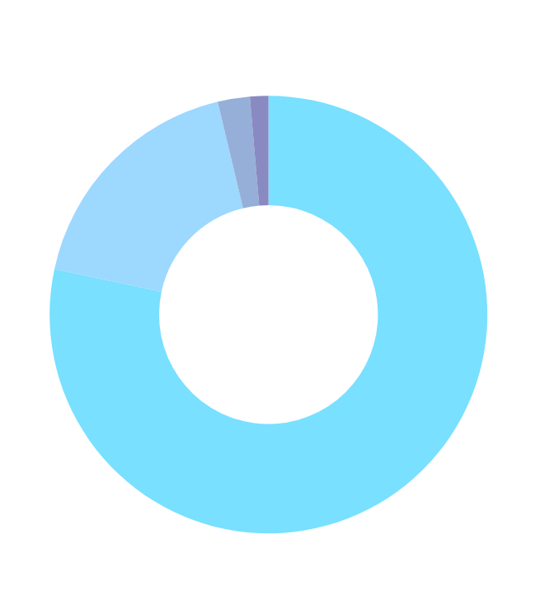
REVENUE BY PAYMENT TYPE
CREDIT CARD: 78.3%
BOLETO: 17.9%
VOUCHERS: 2.4%
DEBIT CARD: 1.36%

Slide 8

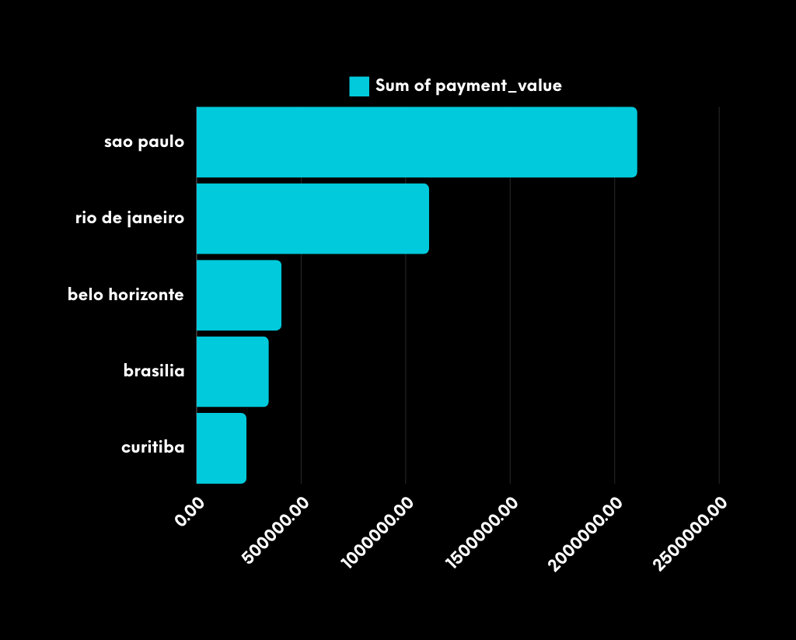

TOP 5 CITIES IN REVENUE
TOP 5 PRODUCT CATEGORY

Slide 9

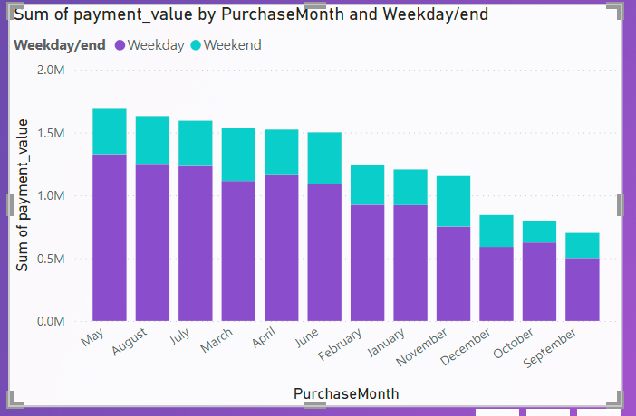
WEEKDAY VS WEEKEND REVENUE

Slide 10
KEY FINDINGS
WEEKDAYS GENERATES MORE REVENUE THAN WEEKENDS.
CUSTOMERS PREFER PAYING BY CREDIT CARDS.
THE AVERAGE DELIVERY TIME IS 12.5 DAYS WHICH NEEDS TO DECREASED.
SAO PAOLO IS THE CITY THAT GENERATES THE HIGHEST REVENUE.
HEALTH AND BEAUTY IS THE CATEGORY THAT GENERATES THE HIGHEST REVENUE.

Slide 11
RECOMENDATIONS
IMPROVE LOGISTICS: FOCUS ON OPTIMIZING DELIVERY TIMES IN REGIONS WITH FREQUENT DELAYS TO IMPROVE CUSTOMER SATISFACTION.
INCREASE PROFIT MARGINS: REVIEW PRICING STRATEGIES FOR LOW-MARGIN CATEGORIES TO IMPROVE PROFITABILITY.
ENHANCE CUSTOMER EXPERIENCE: EXPLORE CUSTOMER FEEDBACK DATA TO FURTHER ENHANCE USER EXPERIENCE AND LOYALTY..

Slide 12
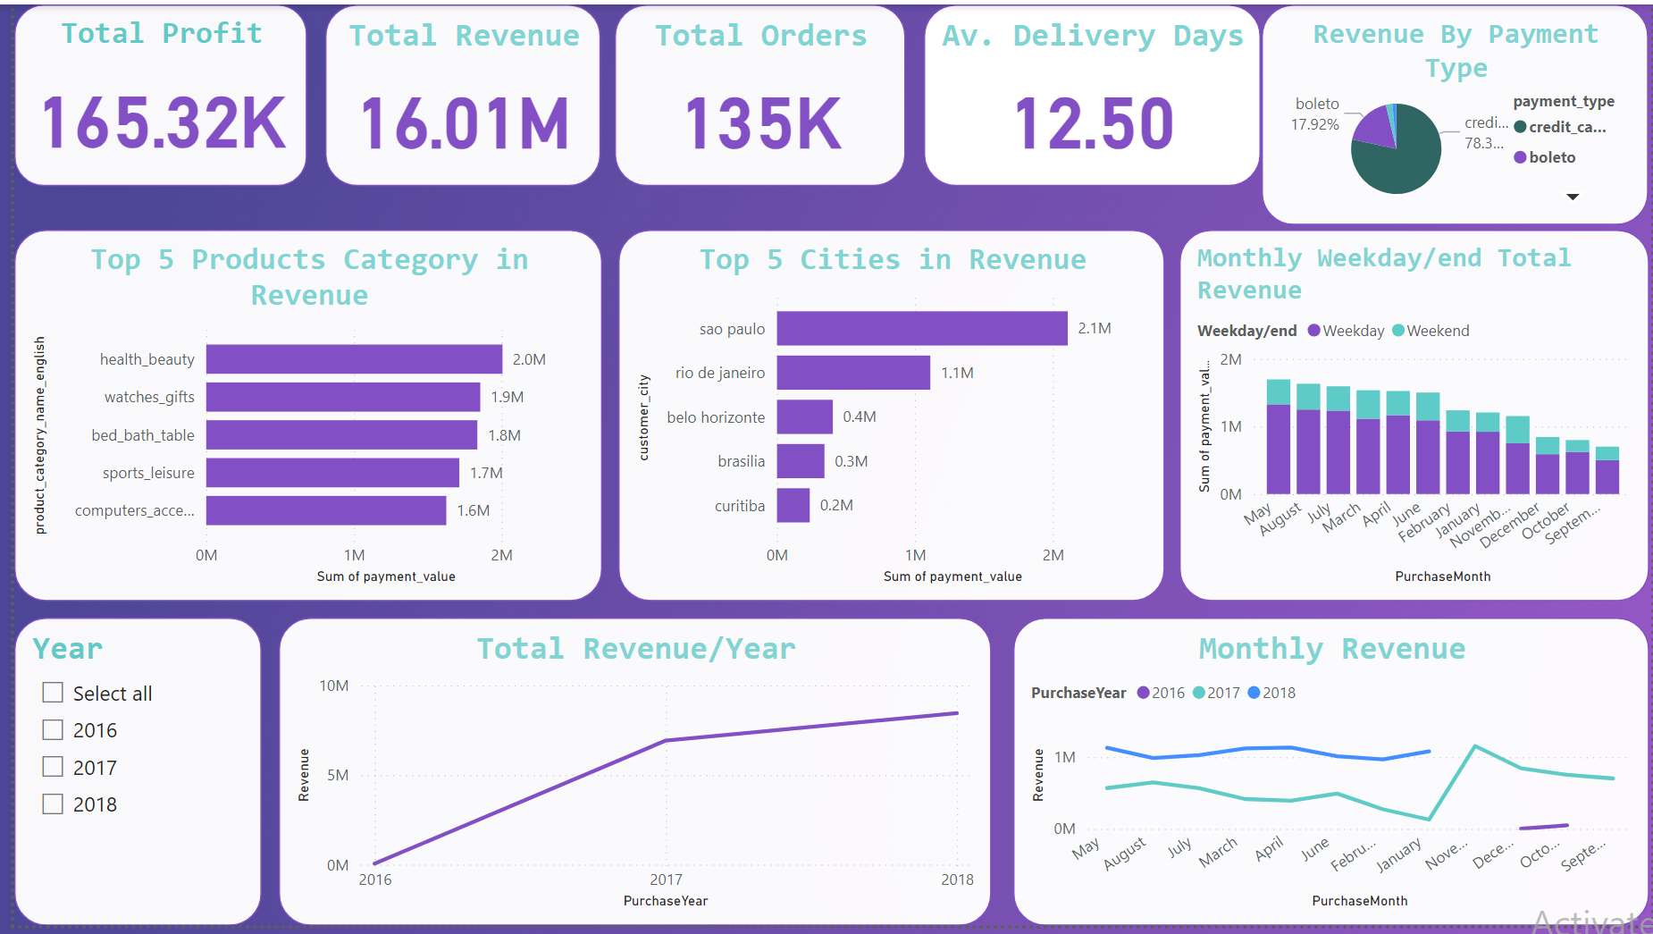

Slide 13

THANK YOU
FEEL FREE TO CONTACT US IF YOU HAVE ANY QUESTIONS
EMAIL: AMALFAROUK84@GMAIL.COM

